Slide 1
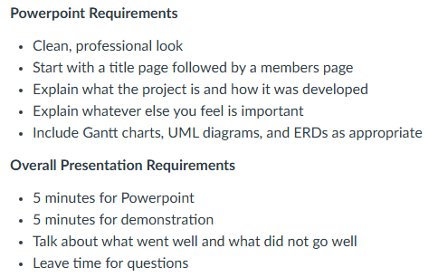
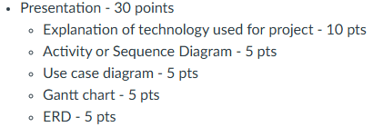




What we need for the presentation (will delete slide before submission)
Need to show:
PowerPoint
Demonstration of working project
Demonstration of at least one API endpoint
Description of demonstration of reasonable unit testing
Notes:
Overall Presentation Requirements
5 minutes for Powerpoint
5 minutes for demonstration
Talk about what went well and what did not go well
Leave time for questions
Title Page

Slide 2

Nutrition Compass
Group 17
Notes:
Overall Presentation Requirements
5 minutes for Powerpoint
5 minutes for demonstration
Talk about what went well and what did not go well
Leave time for questions
Title Page

Slide 3
Group Members
Project Manager/Database: Matthew Eisenberg
Frontend
Ahinya Alwin
William Barrett
Anthony Fetyko
Jia Jones
Backend
Dennis Gorman
Ahmed Salama
Notes:
Members page

Slide 4
Nutrition Compass Background
Takes user’s information to calculate number of calories allotted for the day based on weight goal (loss, gain, or keep current weight)
Keeps track of calories consumed in a day
Keeps track of macros (carbs, protein, and fats) per gram based on allotted calories
User can input food items eaten in a day that updates the daily calorie and macro counts
Notes:
Explain what the project is and how it was developed

Slide 5
Behind the Scenes Math
User info used to calculate total daily energy expenditure (TDEE)
TDEE = Basil Metabolic Rate x Activity Factor
Women BMR = 655 + (9.6 X weight in kg) + (1.8 x height in cm) – (4.7 x age in yrs)
Men BMR = 66 + (13.7 X weight in kg) + (5 x height in cm) – (6.8 x age in yrs)
Activity Factors: Low (1.2), Moderate (1.55), and High (1.725)
For more information: https://steelfitusa.com/blogs/health-and-wellness/calculate-tdee
Notes:
Could be taken out

Slide 6










Technology Used
Team Tech
MERN Components
Notes:
Explanation of tech used for project

Slide 7
Activity Diagram
Login
Create
Account
Update
Account Details
Update
User Info
Add New
Meal
Show Food Options
Edit
Delete
Logout
Notes:
Activity OR sequence diagram

Slide 8
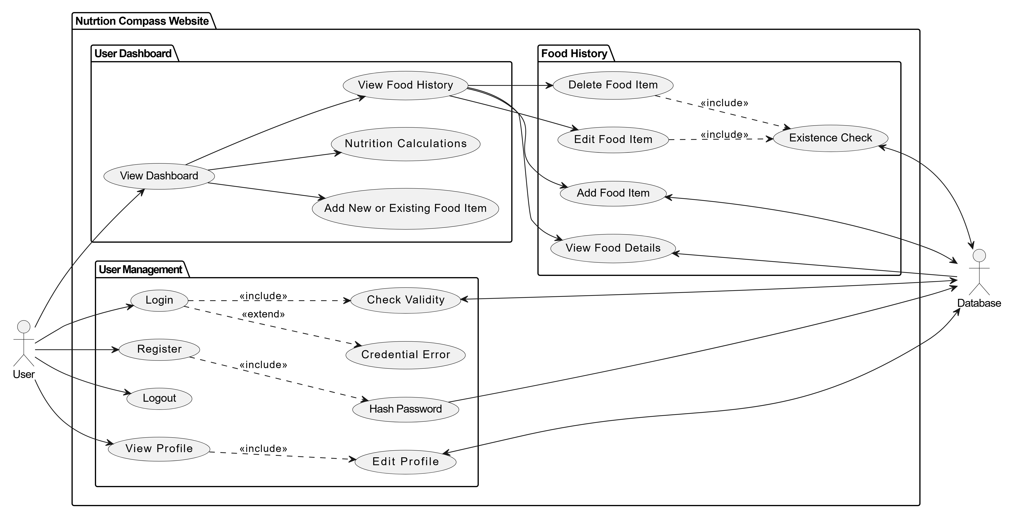
Use Case Diagram
Notes:
Use case diagram

Slide 9
Entity Relationship Diagram
User
ID | Int
FirstName | VarChar
LastName | VarChar
Email | VarChar
Password | VarChar
Age | Int
Weight | Int
Sex | VarChar
Height_Feet | Int
Height_Inches | Int
Activity_Level | VarChar
Weight_Goal | VarChar
Food
Food_Name | VarChar
Food Info
Food_Name | VarChar
Calorie_Count | Int
Carb_Count | Int
Protein_Count | Int
Fats_Count | Int
Notes:
Entity Relationship Diagram

Slide 10
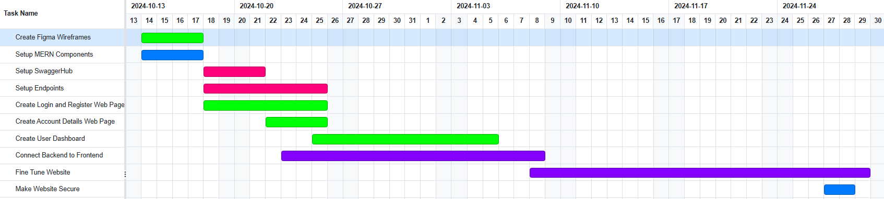
Gantt Chart
Notes:
Gantt chart

Slide 11
What Went Well
Easy to come up with concept and design idea
Use of new tools React allows made for easier website development than that of Vanilla JS
Notes:
What went well

Slide 12
What Did Not Go Well
Time management was difficult as everyone had to balance other classes and finals towards the end of the semester
Notes:
What did not go well

Slide 13
Related Links
This slide contains links related to our project
Project Website: https://nc.matthewe.me/
GitHub:
Notes:
Links for reference

